Slide 1
HOW TO USE NALOXONE
Training for Community members

Slide 2
Why are People Dying from Opioids?
Too much heroin or any opioid causes people to become very sleepy
Their breathing becomes slower and more shallow
Leads to low oxygen levels which causes damage to the heart and brain
Eventually, the heart slows down and stops

Slide 4
North Dakota Law
The Good Samaritan Law was passed to encourage friends, family members, and bystanders to call 911 in the event of an overdose.
In order to be immune from prosecution, you need to:
Seek emergency help - Call 911
Remain onsite until assistance arrives
Cooperate with responding personnel giving emergency medical treatment
The Law provides protection from prosecution for the individual experiencing a drug-related overdose and those seeking the emergency medical assistance.
North Dakota Century Code 19-03.1-23.4

Slide 5
North Dakota Law
According to ND Law, any individual (family, friends, community member) is protected from civil or criminal liability for giving naloxone for a suspected opioid overdose.
North Dakota Century Code 23-01-42

Slide 6
Naloxone Availability In Walsh County
Walsh County Sheriff Office
Grafton Police
Valley Ambulance-Grafton
Park River Ambulance-Park River
Quick Response Units (in process)
Some Walsh County Schools

Slide 7
Naloxone is effective when…
Naloxone will have no effect when…
The overdose is due to usage of:
Heroin
Morphine
Hydromorphone (Dilaudid)
Oxycodone (Oxycontin, Percocet)
Hydrocodone( Norco, Vicodin)
Fentanyl
Buprenorphine
Codeine
Methadone
Although you may not know what the overdose is from, it may be beneficial to administer naloxone. If opioids have been taken with a combination of other drugs the naloxone will negate the opioid effects and could save a life

Slide 8
Notes:
The naloxone takes the place of the opioid in the brain to prevent the effect of the opioid

Slide 9
How Will The Victim React?
When naloxone is used, the person will likely develop symptoms like vomiting, sweating and shortness of breath
These are essentially symptoms of withdrawal from the opioid and not unexpected
A person can have different behaviors and emotions upon waking up from an opioid overdose
Confused
Agitated
Stay very sedated but breathing
Anger
Embarrassment
Frustration
Sadness
**You cannot harm someone by administering naloxone. In many cases, you can save their life!!

Slide 11
What Does an Overdose Look Like?
When you find someone who you think has overdosed, look for the signs:
Slow or shallow breathing
Gasping for air when sleeping
Pale or bluish skin
Slow heartbeat, low blood pressure
Won’t wake up or respond (sternal rub)
Small pupils
Call 911!

Slide 12
Types of Administration
Naloxone can be administered various ways:
IV when under the care of medical providers
Nasal spray-which is what the schools will have
Auto-injector
Intramuscular
Notes:
We are only training on the nasal spray as that’s what we have available to us, but note that there are other types of naloxone.

Slide 13
PRIOR TO NALOXONE Administration
Assess scene – make sure you are safe
Attempt to wake the person by yelling or shaking them
Call 911
Put on gloves
Provide 2 rescue breaths using mask or rescue breathing aid as you don’t know how long they have been laying there

Slide 14
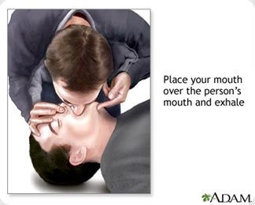
Rescue Breaths
One hand on chin, tilt head back, pinch nose closed
Make seal over mouth, breathe into mouth
1 breath every 5 seconds
Chest should rise, not stomach (if stomach rises, readjust)

Slide 16
Narcan® Nasal Product
Narcan® Administration

Slide 17
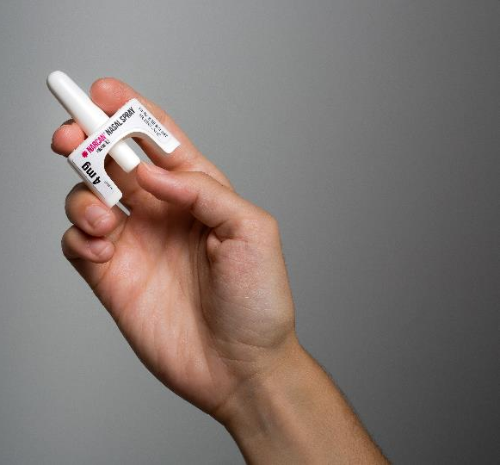
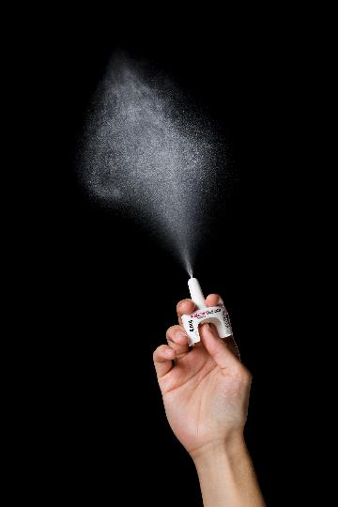
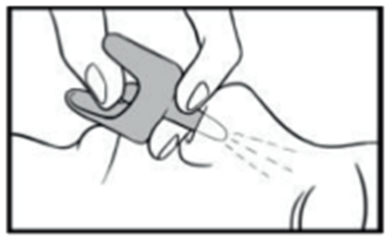
Administer Narcan®
Lay person on their back
Remove from box. Peel back tab with circle to open
Hold with your thumb on bottom of plunger and your first and middle fingers on either side of the nozzle
Tilt person’s head back
Insert tip of nozzle into one nostril until your fingers on either side of nozzle are against bottom of person’s nose
Press plunger firmly to give dose and remove from nostril after giving dose
Administer another dose in same fashion if there is little or no response after 2 minutes
Continue rescue breathing every 5 seconds between doses

Slide 18
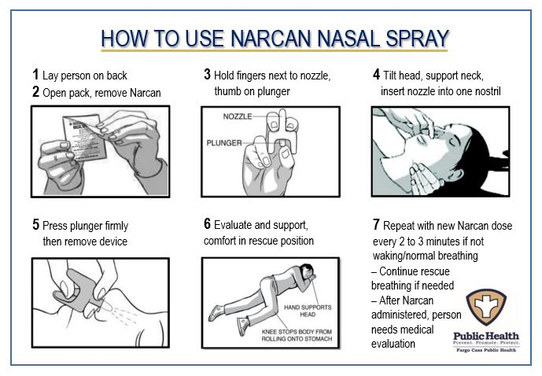

Slide 19
Medication Storage
Naloxone should be kept at room temperature
Do not let it freeze or overheat in your car
It should be protected from light (store in box it came in)
The Naloxone shelf life is about 2 years

Slide 20
Naloxone Administration Trainings available
To schedule a Naloxone Administration Training for your group, contact:
Wanda Kratochvil, RN
701-352-5139
wkratoch@nd.gov

